Slide 1
Test-Driven Development
IT 355
Tina Ostrander

Slide 2
Unit Testing
A unit test is a small, method-level test developers write every time they make a change to the software to prove the changes they made work as expected. ~ Rasmusson

Slide 3
An Example Unit Test
class CalculatorTest extends PHPUnit_Framework_TestCase
{
// Test to ensure that the add method
// returns the sum of two positive ints
public function testAddPositiveInts()
{
$result = $this->calculator->add(1, 2);
$this->assertTrue(3 == $result);
}
}

Slide 4
Why Unit Testing?
Instant feedback
When you make a change to your code and a unit test fails, you instantly know there's a problem.
Reduce testing time
You no longer have to manually retest everything when you make a change.
Reduce debugging time
When a unit test fails, you know exactly where the problem is.
Deploy with confidence
You don't have to worry that you've overlooked something obvious when you deploy.

Slide 5
Technical Debt
Technical debt is the continuous accumulation of shortcuts, hacks, duplication, and other sins we regularly commit against our code base in the name of speed and schedule. ~ Rasmusson

Slide 6
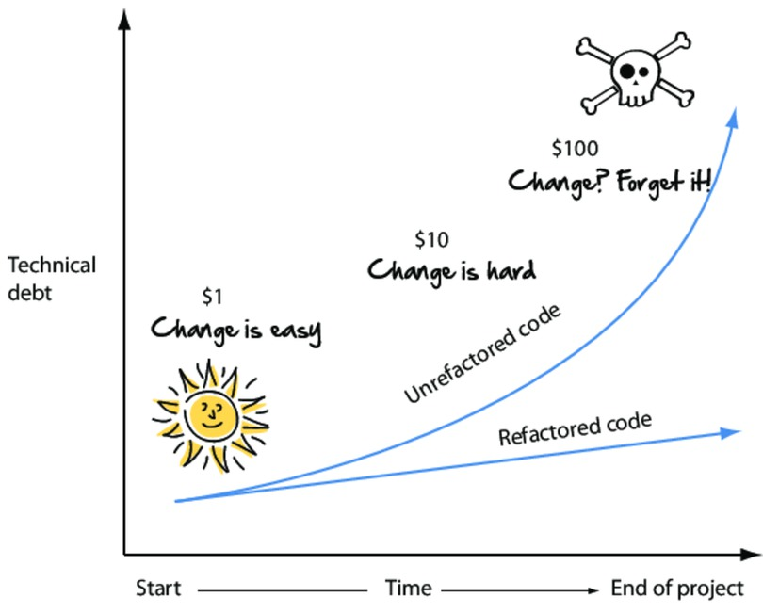
Technical Debt
Notes:
"Each transgression initially made against the code base can seem small or insignificant. But like all forms of debt, it's the cumulative effect that adds up over time that hurts."

Slide 7
Refactoring
Refactoring is the practice of continually making small, incremental design improvements to your software without changing the overall external behavior. ~ Rasmusson

Slide 8
Refactoring
Renaming variables, classes, or methods
Eliminating redundant code
Hide unnecessary detail
Simplify class logic
Simplify code logic
Refactor continuously!

Slide 9
Test-driven Development
Test-driven development (TDD) is a programming technique that requires you to write unit tests before you write the actual code that makes them pass.
Notes:
Abstraction: Make a generic class that can interact with any database, then use inheritance to make a more specific class to talk to a MySQL Database

Slide 10
The TDD Mantra
RED: Write a small test that doesn't work, and perhaps doesn't even compile.
GREEN: Make the test work quickly, committing whatever sins necessary in the process.
REFACTOR: Eliminate all the duplication created in getting the test to work.
- Kent Beck

Slide 11
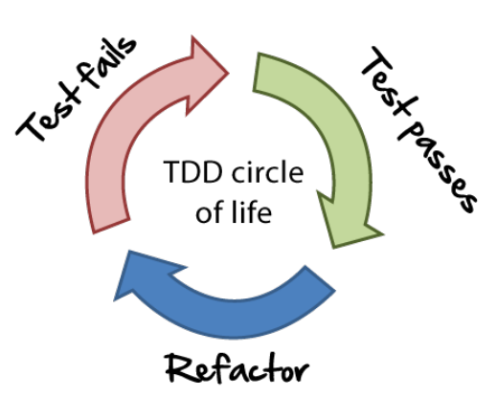
http://www.agilenutshell.com/test_driven_development

Slide 12
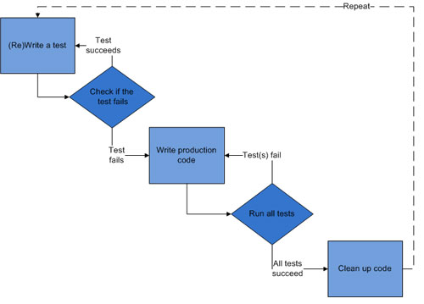
The TDD Cycle
Image courtesy of http://en.wikipedia.org/wiki/Test-driven_development

Slide 13
How does it work?
TDD revolves around a short iterative development cycle:
Write a test
Before writing any code, first write an automated test for your code. While writing the automated tests, take into account all possible inputs, errors, and outputs.
Check if the test fails
Write production code
Run all tests
Clean up code

Slide 14
How does it work?
TDD revolves around a short iterative development cycle:
Write a test
Check if the test fails
The first time you run your automated test, the test should fail—indicating that the code is not yet ready.
Write production code
Run all tests
Clean up code

Slide 15
How does it work?
TDD revolves around a short iterative development cycle:
Write a test
Check if the test fails
Write production code
Afterward, you can begin programming. Since there's already an automated test, as long as the code fails it, it means that it's still not ready.
Run all tests
Clean up code

Slide 16
How does it work?
TDD revolves around a short iterative development cycle:
Write a test
Check if the test fails
Write production code
Run all tests
Once the code passes the specific test, you run all previous tests to make sure that nothing broke. You no longer have to worry about changes that introduce new bugs.
Clean up code

Slide 17
How does it work?
TDD revolves around a short iterative development cycle:
Write a test
Check if the test fails
Write production code
Run all tests
Clean up code
Once the code passes the test, you can then begin cleaning it up, via refactoring.

Slide 18
The Guestbook Application
Assume we're developing a guestbook application where users can add and view guestbook entries.
The markup has been completed.
We're creating a class which contains the application logic of the guestbook.

Slide 19
Getting Started
We'll be using PHPUnit (a TDD framework) on itlamp.greenriver.edu
For Windows, download Putty and launch the executable. On a Mac, open the Terminal Window.
Log in to itlamp via SSH
PC/Putty
Hostname: itlamp.greenriver.edu
Username: username@tech.div
Password: Your tech password
Mac
$ ssh username@tech.div@itlamp.greenriver.edu
Are you sure you want to continue connecting (yes/no)? yes
username@itlamp.greenriver.edu's password: tech password

Slide 20
Getting Started
Create a public_html directory
$ mkdir public_html
Your web URL:
http://itlamp.greenriver.edu/~username@tech.div
The full directory path:
/home/tech.div/username/public_html/tdd

Slide 21
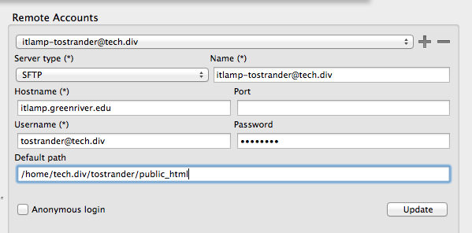
Getting Started
4. Get connected in Komodo Edit via SFTP
Server type: SFTP
Host: itlamp.greenriver.edu
Username: username@tech.div
Default path: /home/tech.div/username/public_html

Slide 22
Define the GuestbookTest Class
Create GuestbookTest.php in a tdd directory
tdd/GuestbookTest.php
<?php
require_once('Guestbook.php');
class GuestbookTest extends PHPUnit_Framework_TestCase
{
}

Slide 23
Fixtures
A fixture is a resource all tests have in common, and which sets the context of the test
Tests are isolated; they do not share information
setUp() and tearDown() are used to create fixtures
Notes:
We’ve defined a setUp() and tearDown() pair of methods. In both SimpleTest and PHPUnit, these are used to create Fixtures. A Fixture is some resource all tests in a test case have in common and which sets the context of the test (the situation in which we’re testing), as well as other repetitive objects or resources. Because each test must be isolated (cannot share information) these methods will tell the Framework to create our Fixture (a My_Fleet instance) before each test, and destroy it after. So each test gets a shiny new version to play with, free of anything a previous test may have done.

Slide 24
Fixtures
tdd/GuestbookTest.php
<?php
require_once('Guestbook.php');
class GuestbookTest extends PHPUnit_Framework_TestCase
{
private $guestbook;
public function setUp(){
$this->guestbook = new Guestbook();
}
public function tearDown(){
unset($this->guestbook);
}
}

Slide 25
Run the Test Script
In the terminal window, navigate to your tdd folder:
$ cd tdd
Run PHPUnit
$ phpunit GuestbookTest.php
What happens? Why?
$ phpunit GuestbookTest.php
PHP Warning: require_once(Guestbook.php): failed to open stream: No such file or directory in /home/tech.div/tostrander/public_html/tdd/GuestbookTest.php on line 3
Notes:
Remember… we write the test(s) before we write the code!
The test should fail.

Slide 26
Define the Class
Create Guestbook.php inside your tdd folder
tdd/Guestbook.php
<?php
class Guestbook
{
}

Slide 27
Run the Test Script
$ phpunit GuestbookTest.php
PHPUnit 4.6.1 by Sebastian Bergmann and contributors.
Time: 130 ms, Memory: 11.75Mb
There was 1 failure:
1) Warning
No tests found in class "GuestbookTest".
FAILURES!
Tests: 1, Assertions: 0, Failures: 1.

Slide 28
Plan Your Tests
Think about:
What your method will do
What possible inputs it will get
What outputs it will send

Slide 29
Assertions
Assertions ensure that a function returns what it is supposed to
Example: if a function is supposed to return true if it's successful, then the test should assert that the return value is equal to true.

Slide 30
Assertion Methods
assertTrue($x) Fail if $x is false
assertFalse($x) Fail if $x is true
assertNull($x) Fail if $x is set
assertEquals($x, $y) Fail if $x == $y is false
assertInstanceOf($x, $y) Fail if $x is not an instance of class $y
assertGreaterThan($x, $y) Fail if $x is not greater than $y
assertLessThanOrEqual($x, $y) Fail if $x is not less than or equal to $y
assertStringEndsWith($x, $y) Fail if $x does not end with $y
assertInstanceOf($x, $y) Fail if $x is not an instance of class $y
assertSame($x, $y) Fail if $x is not the same value and type as $y
Complete list at https://phpunit.de/manual/current/en/appendixes.assertions.html

Slide 31
Write the Test
Test: the Guestbook viewAll() function returns at least one guestbook entry.
tdd/GuestbookTest.php
class GuestbookTest extends PHPUnit_Framework_TestCase
{
…
// Test to ensure that the guestbook
// contains at least one entry
public function testCountGuestbookEntries()
{
$entries = $this->guestbook->viewAll();
$this->assertInternalType('array', $entries);
$this->assertTrue(count($entries) > 0);
}
}
Notes:
when PHPUnit runs this class, it will look for all the functions that start with the word 'test' and run it.
All assertion function names need to begin with "test"

Slide 32
Fail the Test
$ phpunit GuestbookTest.php
PHP Fatal error: Call to undefined method Guestbook::viewAll() in /home/tech.div/tostrander/public_html/tdd/GuestbookTest.php on line 20

Slide 33
Write the Code
tdd/Guestbook.php
<?php
class Guestbook
{
public function viewAll()
{
}
}

Slide 34
Run the Test
$ phpunit GuestbookTest.php
There was 1 failure:
1) GuestbookTest::testCountGuestbookEntries
Failed asserting that null is of type "array".
/home/tech.div/tostrander/public_html/tdd/GuestbookTest.php:21
FAILURES!
Tests: 1, Assertions: 1, Failures: 1.

Slide 35
Write the Code
tdd/Guestbook.php
class Guestbook
{
private $entries = array (
);
public function viewAll() {
return $this->entries;
}
}

Slide 36
Run the Test
$ phpunit GuestbookTest.php
There was 1 failure:
1) GuestbookTest::testCountGuestbookEntries
Failed asserting that false is true.
/home/tech.div/tostrander/public_html/tdd/GuestbookTest.php:22
FAILURES!
Tests: 1, Assertions: 1, Failures: 1.

Slide 37
Write the Code
tdd/Guestbook.php
class Guestbook
{
private $entries = array (
array ('name' => 'Kirk',
'message' => 'Hi, I\'m Kirk.'
),
array ('name' => 'Teresa',
'message' => 'Hi, I\'m Teresa.'
)
);
public function viewAll() {
return $this->entries;
}
}

Slide 38
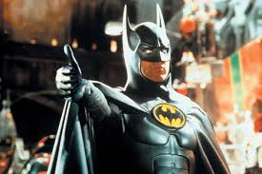
Run the Test
$ phpunit GuestbookTest.php
OK (1 test, 2 assertions)

Slide 39
Write the Test
All test functions have to start with "test"
Test: deleteAll() function removes all guestbook entries and returns an empty array.
tdd/GuestbookTest.php
class TestGuestbook extends UnitTestCase {
…
// Test to ensure that the deleteAll() function
// returns true and creates an empty array
public function testDeleteAll()
{
$return = $this->guestbook->deleteAll();
$this->assertTrue($return);
$entries = $this->guestbook->viewAll();
$this->assertInternalType('array', $entries);
$this->assertTrue(count($entries) == 0);
}
}

Slide 40
Fail the Test
$ phpunit GuestbookTest.php
.PHP Fatal error: Call to undefined method Guestbook::deleteAll() in /home/tech.div/tostrander/public_html/tdd/GuestbookTest.php on line 28

Slide 41
Write the Code
tdd/Guestbook.php
<?php
class Guestbook
{
…
public function viewAll() {
…
}
public function deleteAll() {
$this->entries = array();
return true;
}
}

Slide 42

Run the Test
$ phpunit GuestbookTest.php
OK (2 tests, 5 assertions)

Slide 43
Write the Test
Test: add() function adds a new entry to the guestbook.
tdd/GuestbookTest.php
function testAdd()
{
// Add a new record
$this->guestbook->add("Bob", "Hi, I'm Bob.");
// Get the entries
$entries = $this->guestbook->viewAll();
// Pop the last entry
$entry = array_pop($entries);
//Examine the last entry
$this->assertTrue(isset($entry['name']));
$this->assertTrue($entry['name'] == 'Bob');
$this->assertTrue(isset($entry['message']));
$this->assertTrue($entry['message'] == "Hi, I'm Bob.");
}

Slide 44
Fail the Test
$ phpunit GuestbookTest.php
..PHP Fatal error: Call to undefined method Guestbook::add() in /home/tech.div/tostrander/public_html/tdd/GuestbookTest.php on line 39

Slide 45
Write the Code
tdd/Guestbook.php
<?php
class Guestbook
{
…
public function viewAll() {
}
public function deleteAll() {
}
public function add($name, $message) {
$this->entries[] = array('somename'=>$name,
'somemessage'=>$message);
return true;
}
}

Slide 46
Run the Test
$ phpunit GuestbookTest.php
There was 1 failure:
1) GuestbookTest::testAdd
Failed asserting that false is true.
/home/tech.div/tostrander/public_html/tdd/GuestbookTest.php:48
The assertion failed on line 48:
$this->assertTrue(isset($entry['name']));
So, $entry['name'] is not set.
Can you find the error in the Guestbook class?

Slide 47
tdd/Guestbook.php
<?php
class Guestbook
{
…
public function viewAll() {
}
public function deleteAll() {
}
public function add($name, $message) {
$this->entries[] = array('somename'=>$name,
'somemessage'=>$message);
return true;
}
}
<?php
class Guestbook
{
…
public function viewAll() {
}
public function deleteAll() {
}
public function add($name, $message) {
$this->entries[] = array('name'=>$name,
'message'=>$message);
return true;
}
}

Slide 48

Run the Test
$ phpunit GuestbookTest.php
OK (3 tests, 9 assertions)

Slide 49
Learn More
Watch a video
Beck, K., Gamma, E. Test Infected: Programmers Love Writing Tests
http://junit.sourceforge.net/doc/testinfected/testing.htm
Beck, K. Test-Driven Development. Addison-Wesley, 2002
Gerard Meszaros: xUnit Test Patterns: Refactoring Test Code, Addison-Wesley Professional, 2007
David Astels: Test-Driven Development: A Practical Guide, Prentice Hall, 2003

